Slide 1

Project Title: Disk Scheduling Algorithms

Slide 2
Introduction
Objective: To understand and analyze various disk scheduling algorithms and their impact on system performance.
Scope: This project covers the basic concepts, key algorithms, their advantages, disadvantages, and practical applications.

Slide 3
Disk Scheduling Algorithms
FCFS (First Come First Serve) SSTF (Shortest Seek Time First) SCAN
C-SCAN LOOK
C-LOOK
RSS (Random Scheduling)
LIFO (Last-In First-Out)

Slide 4
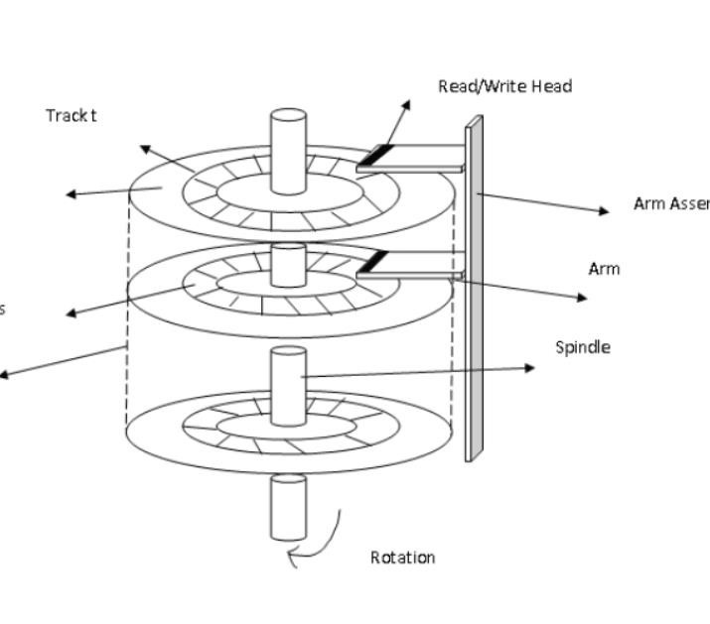
Disk scheduling algorithm in OS

Slide 5
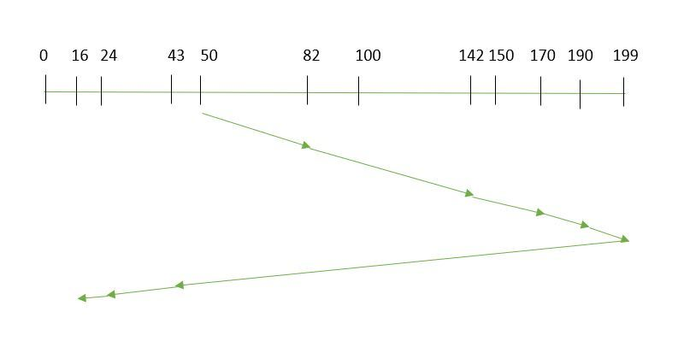
Seek Control by Alternate Navigation (SCAN):
The disk arm moves in a particular direction and services the requests coming in its path and after reaching the end of the disk, it reverses its direction and again services the request arriving in its path. So, this algorithm works as an elevator and is hence also known as an elevator algorithm.
Suppose the requests to be addressed are-82,170,43,140,24,16,190. And the Read/Write arm is at 50, and it is also given that the disk arm should move “towards the larger value”.
Therefore, the total overhead movement (total distance covered by the disk arm) is calculated as=
(199-50) + (199-16) = 332

Slide 6
Seek Control by Alternate Navigation (SCAN):
Advantages of SCAN
High throughput
Average response time
Disadvantages of SCAN
Longer Wait Time For Some Requests for locations just visited by disk arm
Unequal Service Time
Works Well for Heavy Loads

Slide 7

Thank You

